Slide 1
Structures in C
Dr.Sreejith Rajan

Slide 2
What is a Structure
We know various data types in C
Eg: int, float, char etc
These data types are unique and dedicated to specific data and have a fixed size
What if we want to have our own “datatype”
Just like Biriyani or Aviyal

Slide 3
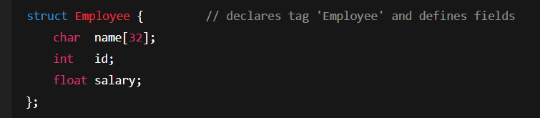
…Continued
Structures in C are user-defined data types that let you group related variables (possibly of different types) under one name.

Slide 4
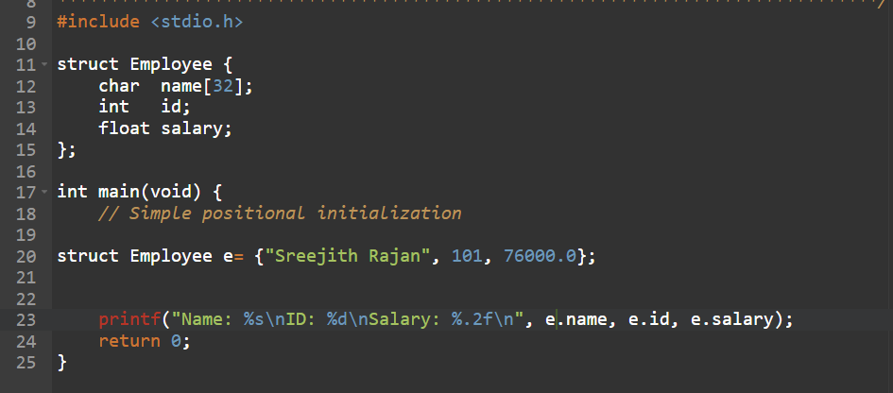
Simple Positional Initialisation and Objects

Slide 5
What if I want to give you more freedom?
I want to enter the name and other values each time I run the program.
What to do?
We learnt scanf;

Slide 6
What if we have 100 employees?
Can we use something you learnt in last class?

Slide 7
Passing Structure to a function
Normal Employee structure
I want a function that can calculate the new salary.
The percentage of increment will be passed through the function. The struct should also be passed.

Slide 8
What did we learn?
Structure
Giving values to structure
Use of a “for loop” in the structure
Passing structure to a function

Slide 9
THANK YOU

